Slide 1
CMIS 3142 - Computational Methods
T. Arudchelvam
Department of CMIS,
Faculty of Applied Sciences,
Wayamba University of Sri Lanka

Slide 2
Areas to be covered
Data Representation and Computational Error:
  Floating-point numbers, rounding rules, machine precision, floating-point arithmetic; well-posed problems, problems vs. algorithms, data error vs. computational error, forward error vs. backward error, conditioning of a problem, stability of an algorithm.
System of Linear Equations:
  Programming aspects for different types of matrices such as full matrix, symmetric matrix, sparse matrix, symmetric sparse matrix, row vector, column vector.
  Program Design for matrices and other relevant Operations, SOR (Successive over relaxation Method), Cholesky Method, ICCG (Incomplete Choleski Conjugate Gradient method).
  Program design for different problems using matrices
Fixed point iteration, Jacobian Matrix, Finite Difference Method

Slide 3
Programming Aspects of Different types of Matrices

Slide 4
Matrix
  Row vector,
  Column vector,
  Full Matrix
  Symmetric matrix,
  Sparse matrix,
  Symmetric sparse matrix.

Slide 5
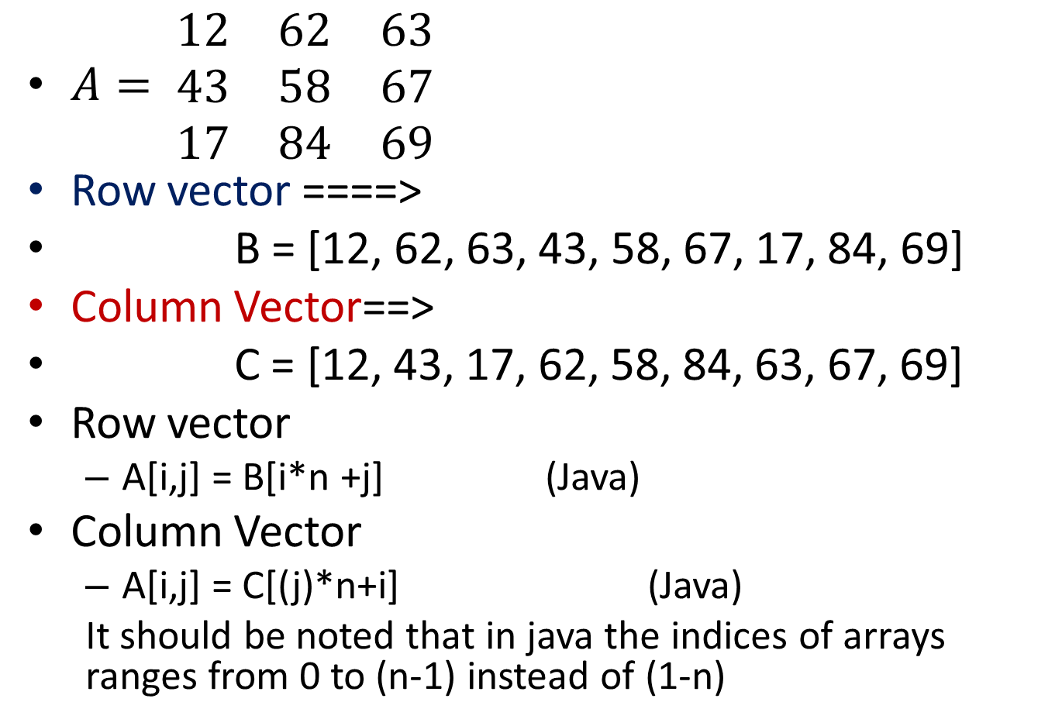
Full (Square) Matrix ===>vector
$A= \begin{matrix}12 & 62 & 63 \\ 43 & 58 & 67 \\ 17 & 84 & 69\end{matrix}$
Row vector ====>
B = [12, 62, 63, 43, 58, 67, 17, 84, 69]
Column Vector==>
C = [12, 43, 17, 62, 58, 84, 63, 67, 69]
Row vector
  A[i,j] = B[i*n +j] (Java)
Column Vector
  A[i,j] = C[(j)*n+i] (Java)
  It should be noted that in java the indices of arrays ranges from 0 to (n-1) instead of (1-n)

Slide 6
Assignment 03
Write a Java program to convert a general matrix A (m*n) into row vector and column vector?
  Read the number of rows
  Read the number of columns
  Read and store the elements
  Display in the matrix form
  Display in the Row Vector form
  Display in the Column Vector form
  Find the location of the row vector where the element of the full matrix A(i,j) is stored. Where i – row number, j – column number
  Find the location of the column vector where the element of the full matrix A(i,j) is stored. Where i – row number, j – Column Number

Slide 7
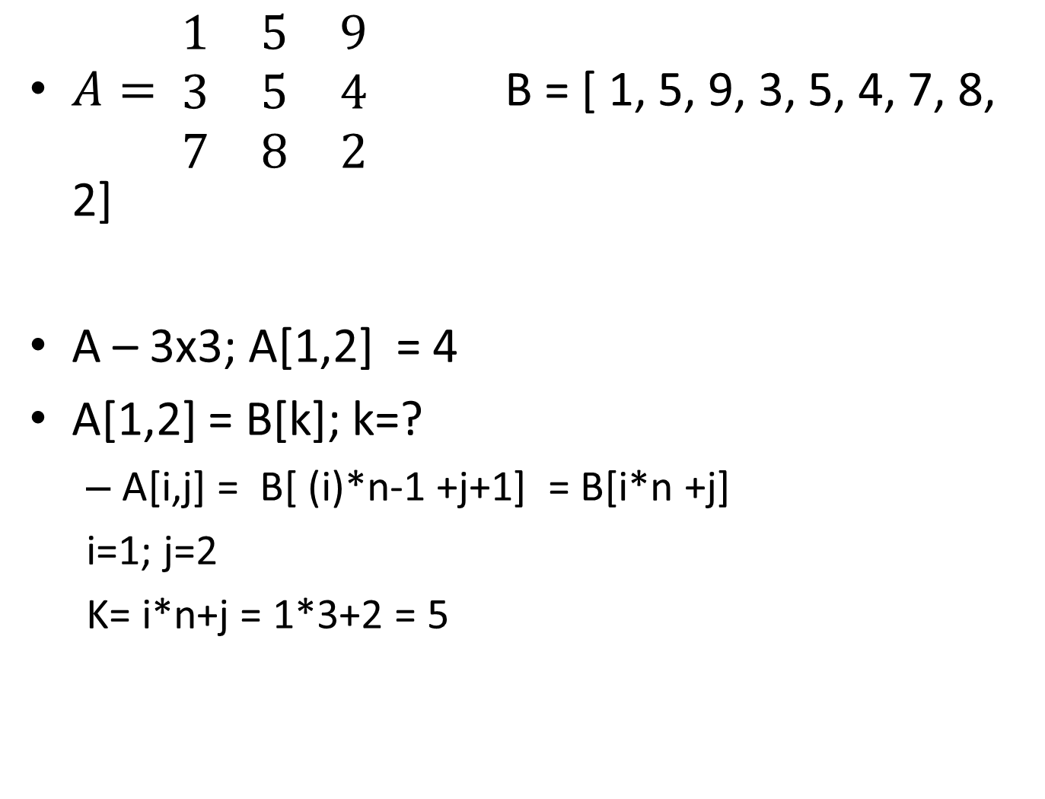
$A= \begin{matrix}1 & 5 & 9 \\ 3 & 5 & 4 \\ 7 & 8 & 2\end{matrix}$ B = [ 1, 5, 9, 3, 5, 4, 7, 8, 2]
A – 3x3; A[1,2] = 4
A[1,2] = B[k]; k=?
  A[i,j] = B[ (i)*n-1 +j+1] = B[i*n +j]
  i=1; j=2
  K= i*n+j = 1*3+2 = 5

Slide 8
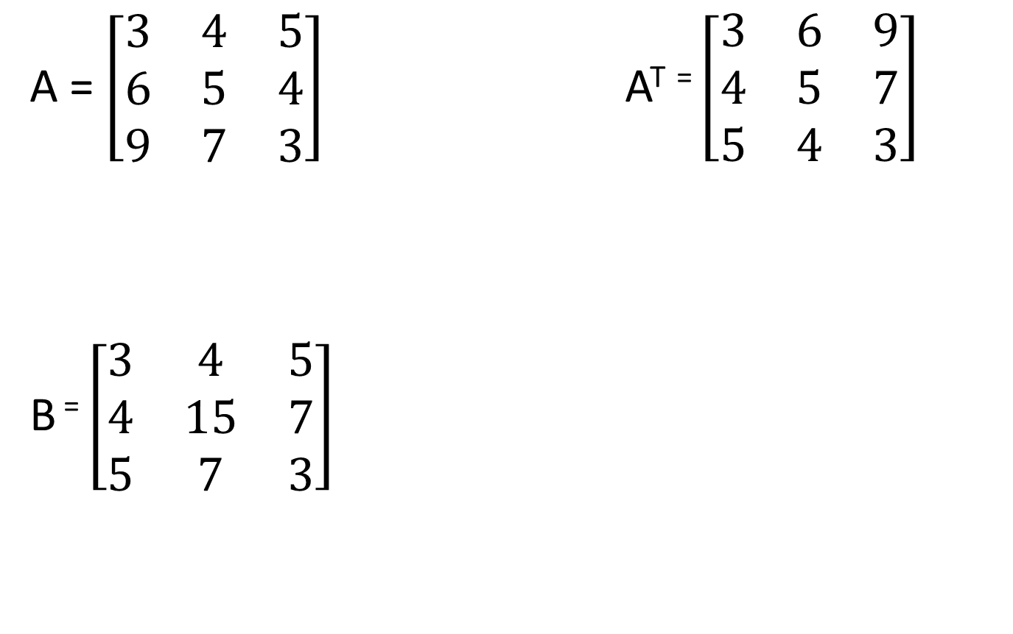
A = $\left[\begin{matrix}3 & 4 & 5 \\ 6 & 5 & 4 \\ 9 & 7 & 3\end{matrix}\right]$A^{T} ⁼ $\left[\begin{matrix}3 & 6 & 9 \\ 4 & 5 & 7 \\ 5 & 4 & 3\end{matrix}\right]$
B ⁼ $\left[\begin{matrix}3 & 4 & 5 \\ 4 & 15 & 7 \\ 5 & 7 & 3\end{matrix}\right]$

Slide 9
Symmetric Matrix
Row ==> i
Col ==> j
(i-1)(i)/2 + i + j
Check with
(i,j) == > (2,1) (3,1), (3,2)

Slide 10
Matrix Abstract
public abstract class Matrix
{
protected int columns;
protected int rows;
public int rowSize()
{ return rows;}
public int columnSize()
{ return columns; }
public abstract void display();
public abstract double elementAt(int i, int j);
public abstract Matrix multiply(double K);
public abstract Matrix multiply(Matrix B);
public abstract columnVector multiply(columnVector B);
public abstract Matrix add(Matrix B);
public abstract Matrix sub(Matrix B);
public abstract void swapRows(int i, int j);
public abstract void swapColumns(int i, int j);
public abstract Matrix transpose();
public abstract Matrix inverse();
}

Slide 11
Exercise
Complete the Java code for the class matrix shown in the previous slide.
General Matrix m*n
  Number of rows: m
  Number of Columns: n
Row vector
Column vector
Symmetric matrix with row vector

Slide 12
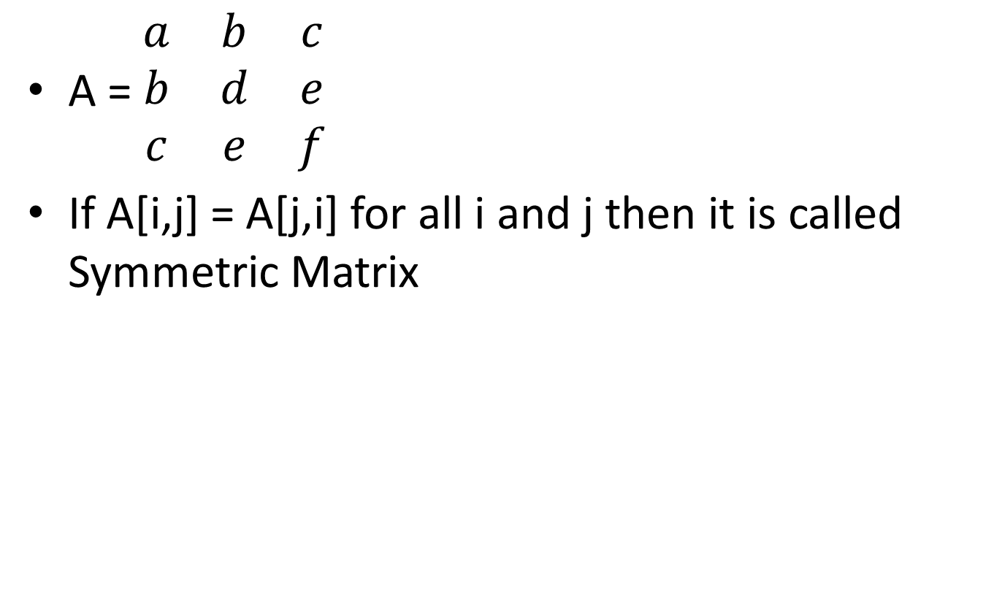
Symmetric Matrix
A = $\begin{matrix}a & b & c \\ b & d & e \\ c & e & f\end{matrix}$
If A[i,j] = A[j,i] for all i and j then it is called Symmetric Matrix

Slide 13
Symmetric Matrix
How to represent?
  Rowvector
  Number of elements
Method “ElementAt()” – write??
Constructors
  symmetricMatrix(int Matsize)
  symmetricMatrix(rowVector A, int Matsize)
  symmetricMatrix(double[] A, int Matsize)
  symmetricMatrix(String datafile, int Matsize)
  symmetricMatrix(Matrix A)

Slide 14
Sparse Matrix
What is meant by sparse matrix?
a sparse matrix is a matrix in which most of the elements are zero.

Slide 15
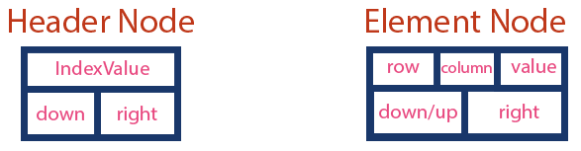
Representing Sparse Matrix

Slide 16
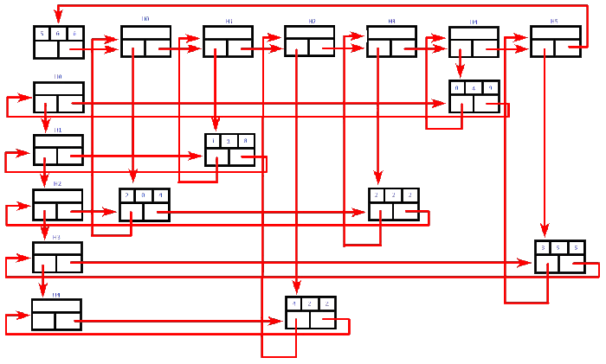
Representing Sparse Matrix

Slide 17
Sparse Symmetric Matrix
rowVector a; // elements
integerVector diagonal; //location of Diagonal elements
integerVector columnNums; // column number of each element
int nElements; // Number of elements
How to write method
  elementAt(int i, int j)

